Slide 1

软件工程专业英语
计算机科学学院
School of Computer Science
Unit 2：Capturing the Requirements

Slide 2
Outline
Part 1, Dialogue: Communication with Customers
Part 2, Translating: Software Requirements

Slide 3
Part 1, Dialogue: Communication with Customers
Main Content
三名学生到Four Seasons Hotel，与酒店的业务经理Mr. White进行沟通，了解业务需求。
重点了解了当顾客没有按时入住时，酒店如何给客户退还押金（预付金）。
视顾客取消预订的及时性的不同，酒店退还不同数额的押金；
普通客户 vs. VIP
旺季（high season） vs. 淡季（low season）

Slide 4
（Kevin, Sharon and Jason come to the four seasons hotel and have a meeting with MR. White, the business manager of the hotel and representative of the end user.）
end user
终端用户，最终用户
The system user serves as the bridge between the end user and the data stored in MDM Server.
这个系统用户充当终端用户与MDM Server中存储的数据之间的桥梁。

Slide 5
Mr. White：Welcome to our hotel.
Kevin: Thank you for giving us the important information about your hotel management needs in your business requirements document. But I am afraid that there are still some questions that we need to be clear about. In order that we can accomplish the system according to your meanings consistently, we would like to ask you a few questions.
Mr. White: Sure.
Sharon: Mr. White. I am drafting the specifications for the Four Seasons Hotel Management Information System, but I found that there may be an important function that is not clear.
Mr. White: Well, what's that?
draft [C] 草稿；草案；草图 [VN] 起草；草拟 [VN] 选派；抽调
I've made a rough draft of the letter.
我已经写好这封信的草稿。
He drafted a standard letter to the editors.
他起草了一份给编辑的标准信函。
final draft 定稿，终稿

Slide 6
Sharon: In the case that a customer books a room in your hotel, but doesn't check in on time. How do you refund his deposit [dɪˈpɒzɪt], the whole, part or none? It will relate to how to depict [dɪˈpɪkt] and model the scenario of the deposit refund and how to design the module.
relate
[VN] ~ A (to B) 联系；把…联系起来
[VN] ~ sth (to sb) 叙述；讲述；讲（故事）
relate to sth/sb
涉及；与…相关；谈到
了解；体恤
In the future, pay increases will be related to productivity.
以后，工资的增加将和业绩挂钩。
He related the facts of the case to journalists.
他给记者们讲述了这件事的实际情况。
We shall discuss the problem as it relates to our specific case.
我们应针对我们的具体情况来讨论这个问题

Slide 7
Kevin: Yes, it is indeed significant for us to define a clear deposit refund mechanism in the system, because it will not only determine the design of the module itself, but also relate to other modules such as the total amount of the charge. After defining the work flow exactly, we will able to know how to deal with it in the system accordingly.
Mr. White: Well, I see. It is indeed a necessary item in the room booking service. Now let me explain to you our way in that situation. Usually, if a customer cancels his booking up to 24 hours before check-in, we will refund the deposit; and up to 12 hours before check-in, we will refund half, but if the cancellation comes within 12 hours, we don't refund anything.

Slide 8
Kevin: OK. Well, besides that, how is the rate of the refund deposit determined? Is there any difference between the VIP and common customers, or between the high season and low season?
Mr. White: In our hotel, there is no difference on the rate between the VIP and common customers. But we have distinctive [dɪˈstɪŋktɪv] criteria [kraɪ'tɪriə] in different seasons. From May to October of every year, because of the high season, the timeline for booking cancellation is moved forward, 12 hours earlier than the low season which is from this November to next April. The customer must cancel his booking up to 36 hours before check-in if he determines and wants the whole deposit refunded. If the cancellation is between 36 and 24 hours prior to expected arrival, the refund would be half, and in case of within 24 hours, no refund.
Kevin: Yes, I've got it. And now it seems clear and more detailed. We will finish the requirements specification in the next three days, and then send it to you this Friday by E-mail.
prior to 在…之前
Note that you must reboot prior to this change taking effect.
请注意，在这项更改生效之前，您必须重新启动。

Slide 9
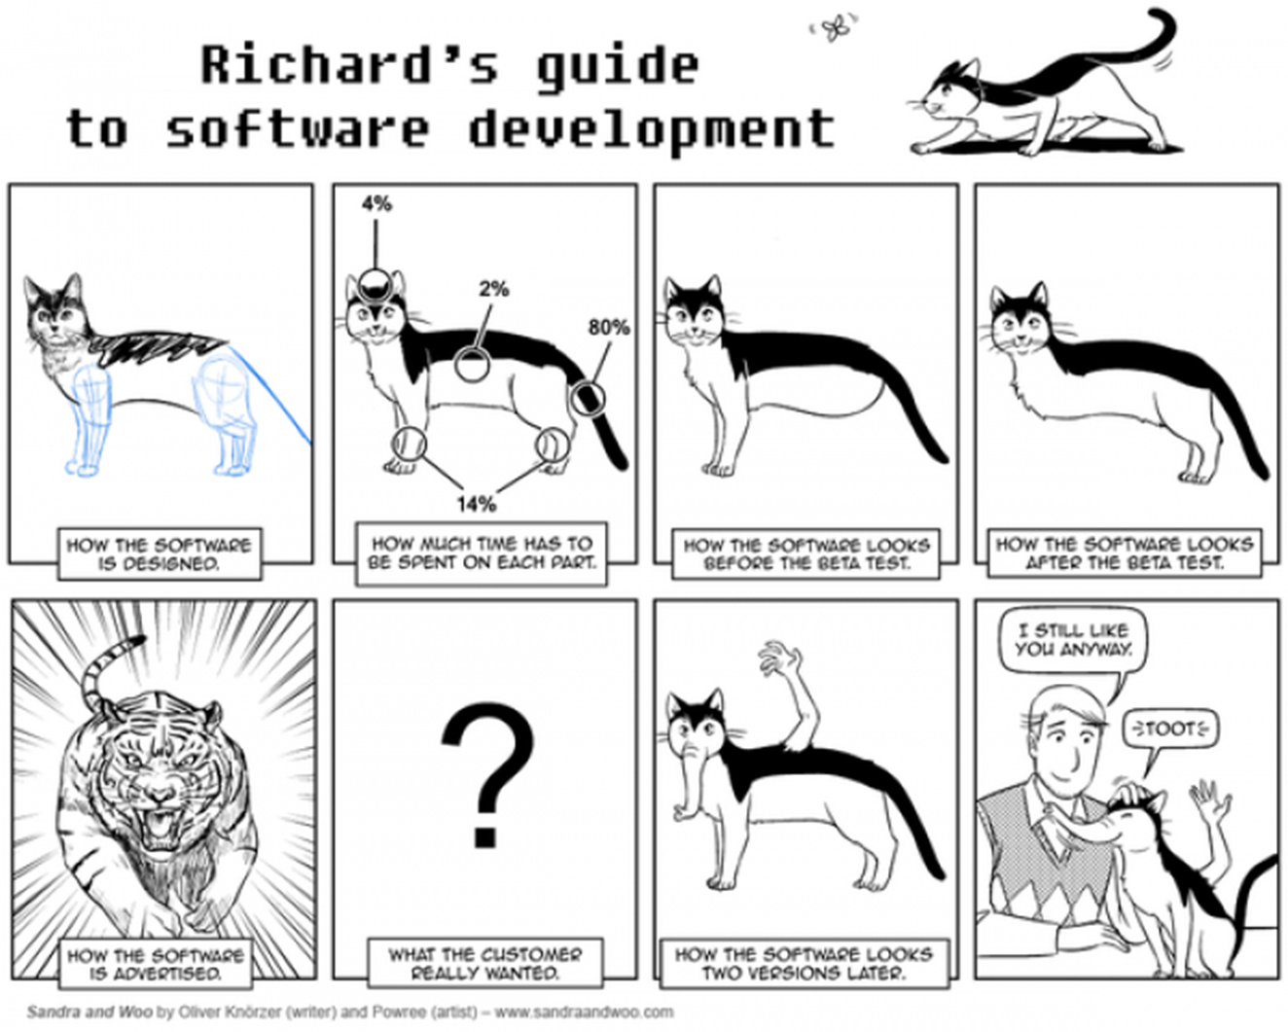
Fun Time

Slide 10
Outline
Part 1, Dialogue: Communication with Customers
Part 2, Translating: Software Requirements

Slide 11
The 1st paragraph
The main goal of the requirements phase is to produce the software requirements specification (SRS), which accurately [ˈækjərətli] captures the client's requirements and which forms the basis of software development and validation [ˌvælɪˈdeɪʃən]. The basic reason for the difficulty in specifying software requirements comes from the fact that there are three interested parties – the client, the end users, and the software developer. The requirements document has to be such that the client and users can understand it easily and developers can use it as a basis for software development. Due to the diverse parties involved in software requirements specification, a communication gap exists. This make the task of requirements specification difficult.
captures the client‘s requirements：获得客户的需求
validation vs. verification ?

Slide 12
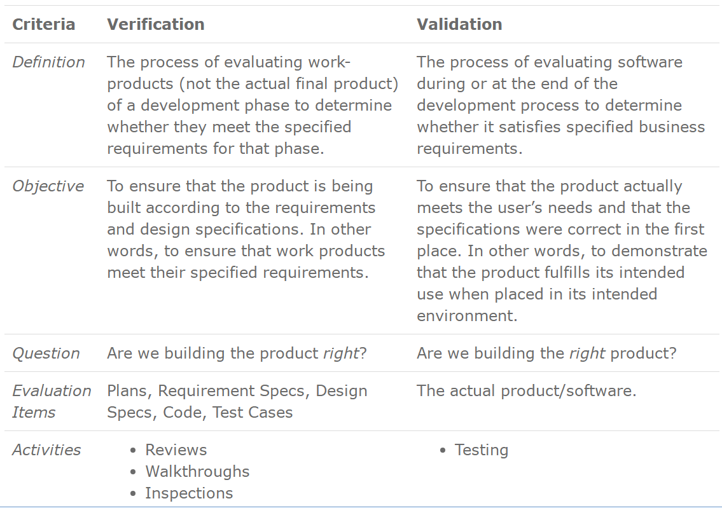
The 1st paragraph
Difference between validation and verification
核实/检查过程的正确性（按需求和设计说明书中的要求执行）
核实/确认结果的正确性（产品符合客户的需求）

Slide 13
The 1st paragraph
The main goal of the requirements phase is to produce the software requirements specification (SRS), which accurately captures the client's requirements and which forms the basis of software development and validation [ˌvælɪˈdeɪʃən]. The basic reason for the difficulty in specifying software requirements comes from the fact that there are three interested parties – the client, the end users, and the software developer. The requirements document has to be such that the client and users can understand it easily and developers can use it as a basis for software development. Due to the diverse parties involved in software requirements specification, a communication gap exists. This make the task of requirements specification difficult.

Slide 14
The 2nd paragraph
There are three basic activities in the requirements phase. The first is problem or requirement analysis. The goal of this activity is to understand such different aspects as the requirements of the problem, its context, and how it fits within the client's organization. The second activity is requirements specification, during which the understood problem is specified or written, producing the SRS. And the third activity is requirements validation, which is done to ensure that the requirements specified in the SRS are indeed what we were desired.
Three activities in the requirement phase: 1) Requirement analysis 需求分析；
2) Requirement specification 需求说明； 3) Requirement validation 需求确认
producing the SRS: 分词短语作状语，表示行为的方式与结果、伴随动作，或对谓语进行补充说明。
An object in motion may strike other ones, exerting forces on them and moving them.
运动着的物体会碰撞其它物体，从而对它们施力并使其运动。

Slide 15
The 3rd paragraph
There are three main approaches to analyze. Unstructured approaches rely on interaction between the analyst, customer, and user to reveal all the requirements (which are then documented). The second is the modeling-oriented [ˈɔːrientɪd] approach, in which a model of the problem is built based on the available information. The model is useful in determining if the understanding is correct and in ensuring the order requirements have been determined. Modeling may be function-oriented or object-oriented. The third approach is the prototyping approach in which a prototype is built to validate the correctness and completeness of requirements.
Three approaches to analyze：1）Unstructured 非结构化的；2）Modeling-oriented 面向建模的：function-oriented 面向功能的，object-oriented 面向对象的；3）Prototyping 原型化的

Slide 16
The 4th paragraph
To satisfy its goals, a SRS should possess characteristics like completeness, consistency [kənˈsɪstənsi], unambiguous [ˌʌnæmˈbɪɡjuəs], verifiable [ˈverɪfaɪəbl], modifiable, etc. A good SRS should specify all the functions the software needs to support, performance of the system, the design constraints that exist, and all the external interfaces.
unambiguous
adj.意思清楚的;明确的;毫不含糊的;无歧义的

Slide 17
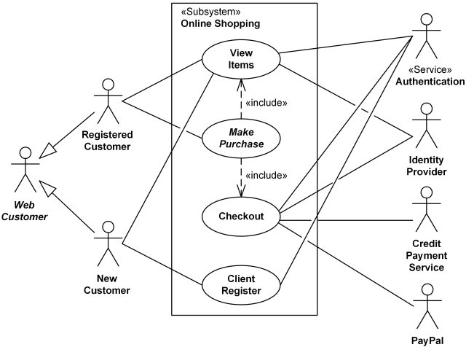
The 5th paragraph
One method for specifying the functional specifications that has become popular is the use case approach. With this approach, the functionality of the system is specified for use cases, with each use case specifying the behavior of the system when a user interacts with it for achieving some goal. Each use case contains a normal scenario, as well as many exceptional scenarios, thereby providing the complete behavior of the system. Though use cases are meant for specification, as they are natural and story-like, by expressing them at different levels of abstraction they can also be used for problem analysis.
use case: description of the behavioral requirements of a system and its interaction with a user. More formally, a use case defines a set of use case instances or scenarios.

Slide 18
The 5th paragraph
One method for specifying the functional specifications that has become popular is the use case approach. With this approach, the functionality of the system is specified for use cases, with each use case specifying the behavior of the system when a user interacts with it for achieving some goal. Each use case contains a normal scenario, as well as many exceptional scenarios, thereby providing the complete behavior of the system. Though use cases are meant for specification, as they are natural and story-like, by expressing them at different levels of abstraction they can also be used for problem analysis.
独立分词结构，作补充说明
With this approach, the functionality of the system is specified through use cases, with each use case specifying the behavior of the system when a user interacts with it for achieving some goal.
利用这个方法，系统的功能通过用例来说明，每个用例都描述了当用户为了实现某个目的而与系统进行交互时的系统行为。

Slide 19
The 5th paragraph
One method for specifying the functional specifications that has become popular is the use case approach. With this approach, the functionality of the system is specified for use cases, with each use case specifying the behavior of the system when a user interacts with it for achieving some goal. Each use case contains a normal scenario, as well as many exceptional scenarios, thereby providing the complete behavior of the system. Though use cases are meant for specification, as they are natural and story-like, by expressing them at different levels of abstraction they can also be used for problem analysis.
独立分词结构，表结果
每个用例都包含一个正常场景以及许多例外场景，因而能提供系统完整行为的描述。

Slide 20
The 5th paragraph
One method for specifying the functional specifications that has become popular is the use case approach. With this approach, the functionality of the system is specified for use cases, with each use case specifying the behavior of the system when a user interacts with it for achieving some goal. Each use case contains a normal scenario, as well as many exceptional scenarios, thereby providing the complete behavior of the system. Though use cases are meant for specification, as they are natural and story-like, by expressing them at different levels of abstraction they can also be used for problem analysis.
插入语
方式状语
尽管用例是为规格说明而设定的，但由于其自然性和故事性，通过在不同的抽象级别上表达用例，用例也可以用于问题分析。

Slide 21
The last paragraph
For validation, the most commonly used method is reviewing or inspecting the requirements. In requirements inspections, the team of reviews also includes a representative of the client to ensure that all requirements are captured.

